Slide 1
Resources/Data/Expeditions Working Group

Slide 2
High-level Summary of Current Activities
Expeditions
Biodiversity: significant improvements in Lifemapper utility and portability
Student Challenge, Demo
Lake Ecology: Network Overlay (IPOP) + Condor + GLEON.
PRAGMA-ENT: First experiments now able to run. Testbed evolution.
Technology Development
Personal Cloud Controller - multi-site virtual cluster creation via enhanced PCC-HTCondor (VM GAHP) and Condor DAG capabilities. IPOP integration
Fingerprinting Applications to discover Software dependencies. Demo
Support
Virtual Cluster Allocated @ UCSD for Cyberlearning Expedition

Slide 3


Virtual Biodiversity Expedition Lifemapper/Rocks update
Goal
Prepare Lifemapper components to be deployed alone or together to work on user-defined and restricted data, i.e. licensed satellite data and sensitive occurrence data for Mount Kinabalu, Sabah, Malaysia
Activities
Generalize Lifemapper code
Create installation process
Simplify configuration
Create installation scripts
Automate deployment
Deploy at institution
Deploy on a laptop for fieldwork and teaching
Learn to work together efficiently
Meet in person for debugging sessions
Maintain ongoing conversation to improve process
Repeat mantra: Don’t jump to conclusions

Slide 4




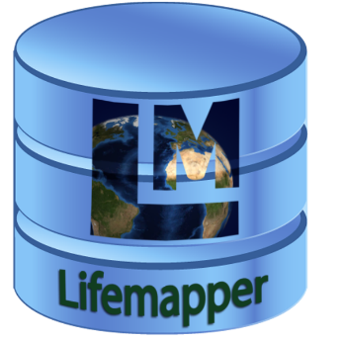
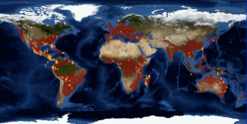

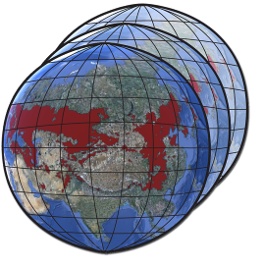
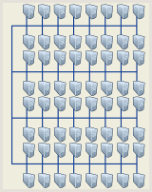
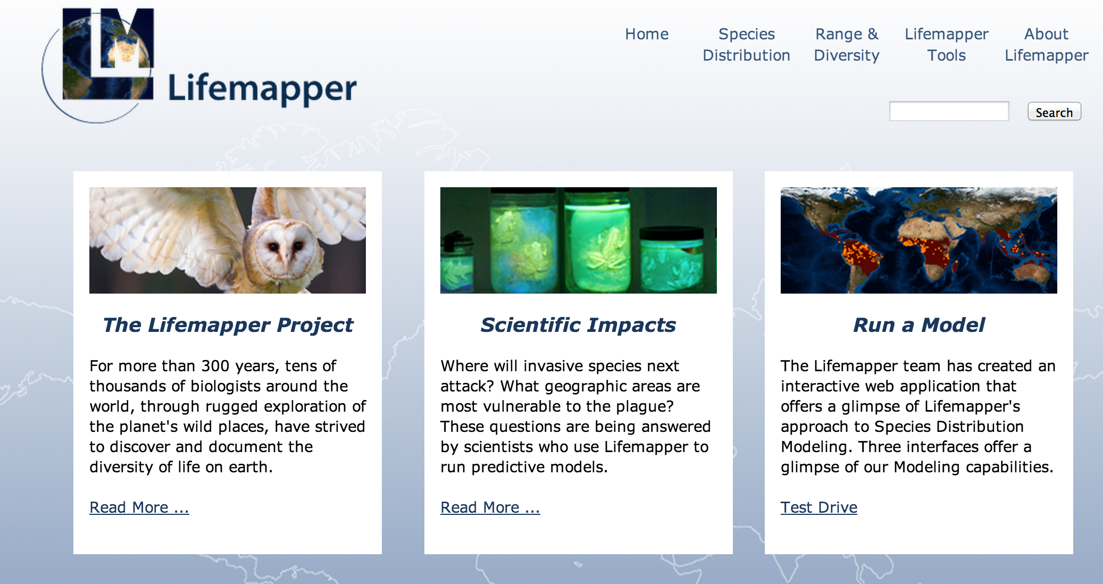

Virtual Biodiversity Expedition Lifemapper/Rocks update
Lifemapper server cluster
Goals
Decouple LmDbServer and LmWebServer from KU-specific implementation
Automate install and configure process
Bootstrap database
Automate database definition
Automate static input data seeding
Run job pipeline on LmDbServer
Read and insert dynamic input species data
Create job-chain for each input species
Deploy and connect LmCompute
Request jobs from LmWebServer
Calculate jobs
Return results to LmWebServer
People
KU: Aimee Stewart
UCSD: Nadya Williams
LmDbServer
Pipeline
Species
Climate
Maps & Models
Data updater
Job tracker
Predicted habitat
PAM assembly
LmCompute
Cluster
LmWebServer
External Clients
QGIS, Browser, Python Client
LmSDM
Website
REST Web Services
LmRAD
Visualize, Explore, Analyze
Submit job
Request data
Post result

Slide 5
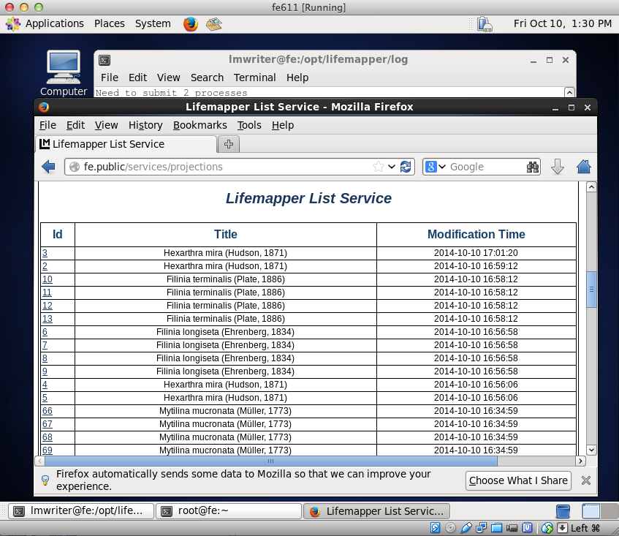
Virtual Biodiversity Expedition Lifemapper/Rocks update
Accomplishments
Run all Lifemapper components outside of KU
Create Lifemapper component ISOs for remote installations
Deploy in 2 virtualization tools
KVM: 2 clusters
rocks-201 as a compute component
rocks-204 as server component
VirtualBox:
Run a 2-node cluster
frontend as a server + LmCompute component
compute node as LmCompute for executing the jobs.
Time from VM import to running pipeline ~1 hr (includes data import and seeding)
Run Lifemapper Server for student challenge
VirtualBox installation:
Lifemapper web page for computed projections

Slide 6
PRAGMA-GLEON Expedition Goals
Beginning to learn how an extreme ecosystem phenomenon – algal blooms – is expressed in observational data from sensor networks
And just how computationally challenging reproducing those events in model simulations can be
We apply PRAGMA technologies to tackle distributed computing in an innovative way
Enabling the community to pool together resources across institutional boundaries, and allowing researchers to continue to use a computer environment they are used to
Distributed HTCondor Windows pool connected by IPOP virtual network overlay

Slide 7
People
U. Wisconsin
Paul Hanson, Craig Snortheim
Virginia Tech
Cayelan Carey, Jon Doubek
U. Florida
Renato Figueiredo, Ken Subratie, Youna Jung

Slide 8
Activities
Close collaboration
Computer science and lake ecology researchers
Student engagement; excursion (this PRAGMA)
Community engagement: GLEON’16 workshop
Documentation
How-tos, installation and use; GitHub Wiki
IPOP development and deployment
Windows service, packaging, XMPP service
HTCondor integration
Generation of HTCondor submit files for GLM model

Slide 9
Accomplishments
Deployment and documentation of Windows HTCondor pool and IPOP overlay
Manager+workers at UF (growing to 48 cores)
Submit+workers at Uwisc and VT
https://github.com/GRAPLE/documentation/wiki
Will present demonstration at this PRAGMA
Joint workshop at GLEON’16

Slide 10
PRAGMA 27 PRAGMA Experimental Network Testbed (ENT)
Maurício Tsugawa (UF)
Kohei Ichikawa (NAIST)

Slide 11
ENT Goals
Build a breakable international SDN testbed for use by PRAGMA researchers
By no means a production system
Complete freedom to access and configure network resources
Provide access to SDN hardware/software to PRAGMA researchers
Offer networking support for PRAGMA multi-cloud and user-defined trust envelopes

Slide 12
ENT Members
University of Florida
Maurício Tsugawa
Osaka University
Shinji Shimojo
Susumu Date
Yasuhiro Watashiba
Yoshiyuki Kido
Nara Institute of Science and Tech
Kohei Ichikawa
Pongsakorn U-chupala
Chawanat Nakasan
University of California, San Diego
Phil Papadopoulos
Luca Clementi
Advanced Industrial Science and Tech
Atsuko Takefusa
Yoshio Tanaka
Jason Haga
Indiana University
Jim Williams
Jennifer Schopf
National Institute of Information and Communications Technology
Jin Tanaka
Hiroaki Yamanaka
Jilin University
Xiaohui Wei
Computer Network Information Center – Chinese Academy of Sciences
Ren Young Mao
Kejun Dong
National Center for High-performance Computing
Fang-Pang Lin
Te-Lung Liu
Li-Chi Ku
Kasetsart University
Putchong Uthayopas

Slide 13
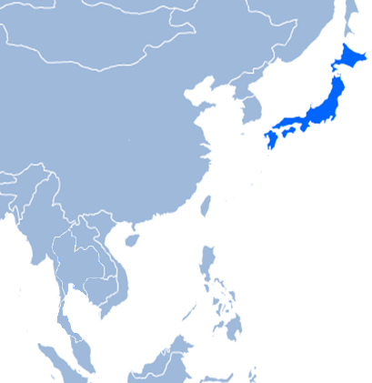
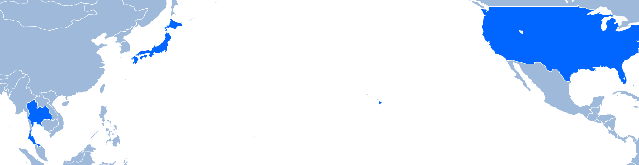
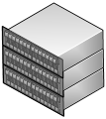

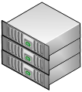











ENT Activities
ENT Backbone
VLANs allocated, mapped, and peered (FLR, Internet2, JGN-X, and Pacific Wave), connecting UF, UCSD, NAIST, AIST, and Osaka U.
TWAREN to be configured soon.

Slide 14
ENT Activities
Controllers and applications
Rocks provisioning through ENT
Network slicing technology (AutoVFlow by H. Yamanaka) being evaluated in ENT
Virtual cluster across ENT to run dock (DEMO)
Controller for multipath routing (DEMO)

Slide 15
ENT Accomplishments
ENT backbone live
Layer 2 connectivity between UF, UCSD, NAIST, AIST, and Osaka U.
Alternative paths established through GRE tunneling for multipath routing research
Successful “remote” provisioning
Rocks front-end at UCSD provisioning a node at UF
OpenFlow Controllers and Applications under development

Slide 16
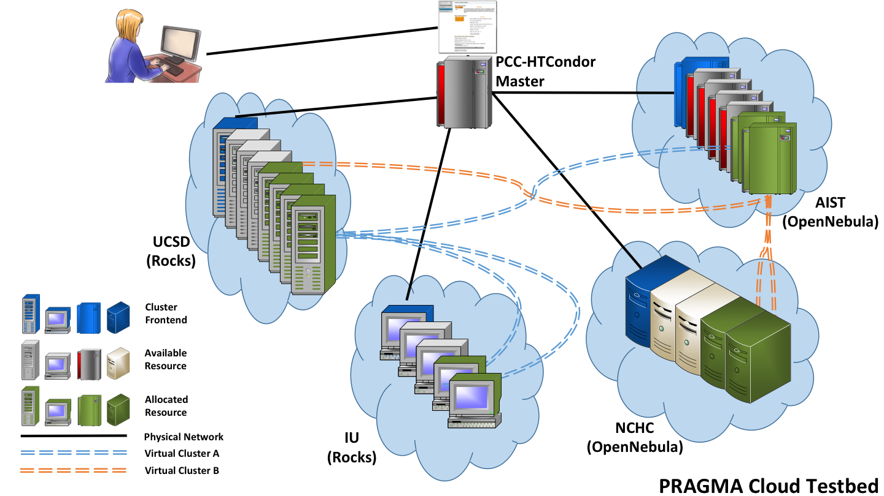


Personal Cloud Controller (PCC) (Yuan Luo, Shava Smallen, Beth Plale, Philip Papadopoulos)
Goals:
Enable lab/group to easily manage application virtual clusters on available resources
Leverage PRAGMA Cloud tools: pragma_bootstrap, IPOP, ViNE.
Lightweight, extends HTCondor from U Wisc.
Provide command-line and Web interfaces
Working Group: Resources

Slide 17
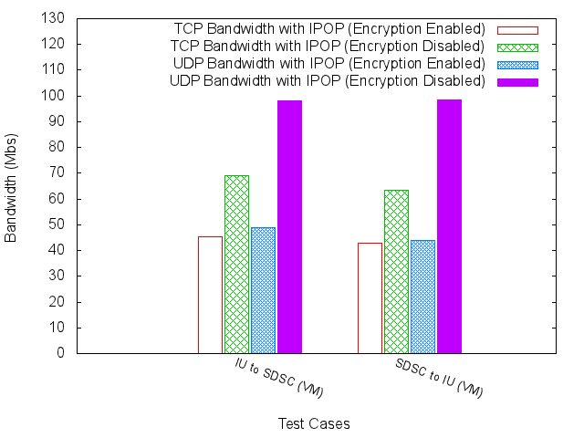
PCC Activities and Accomplishments (since April 2014)
Experimented with IPOP and measured initialization and bandwidth performance between IU and SDSC
Drafted a paper “A Personal Cloud Controller Framework” for submission.

Slide 18
PCC Activities and Accomplishments (cont.) (since April 2014)
Developed new IPOP Rocks roll for easy installation of IPOP to any Rocks virtual cluster
(thanks to Nadya Williams!)
Added automated IPOP server/client initialization to pragma_boot

Slide 19
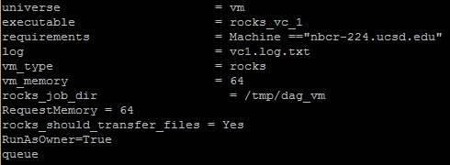
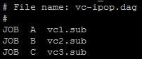
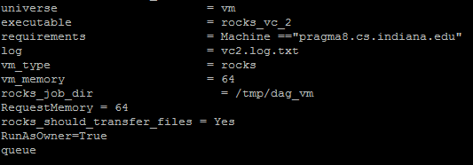
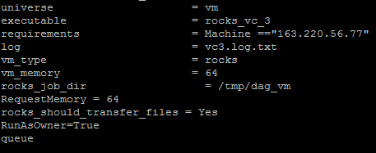

PCC Activities and Accomplishments (cont.) (since April 2014)
Enabled multi-site virtual cluster creation via enhanced PCC-HTCondor (VM GAHP) and Condor DAG capabilities
Will demo between SDSC, IU, and AIST
HTCondor DAG
Parallel pragma_boot jobs

